Slide 1
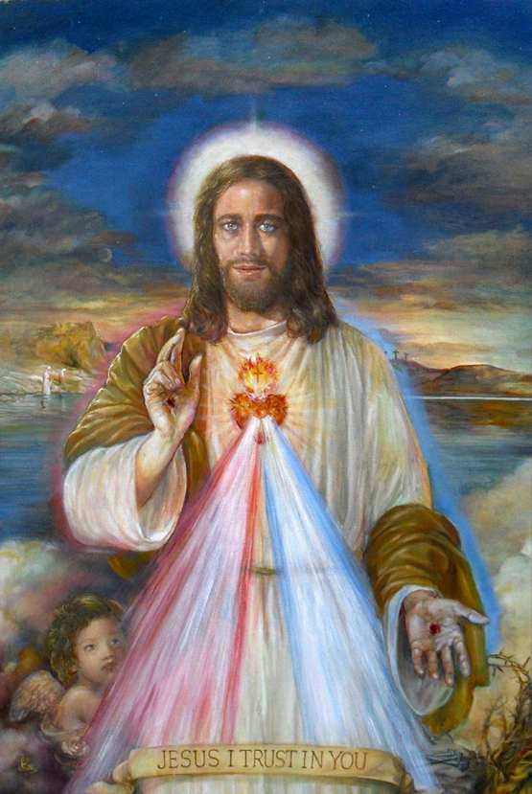
Peaceful Hearts, Zealous Hearts
A Crash Course on Not Crashing and Burning While Being Restored in Life with the Sacred Heart of Jesus and His Divine Mercy
By: Dcn. Gerard-Marie Anthony

Slide 2
Crash and Burn- The World is Lovesick
World appears to burning because it is love-sick and it is love-sick because it has forgotten love
Fire and love have become detached!!

Slide 3
This love does exist
The Sacred Heart of Jesus and His Divine Mercy
Image by Belita William

Slide 4
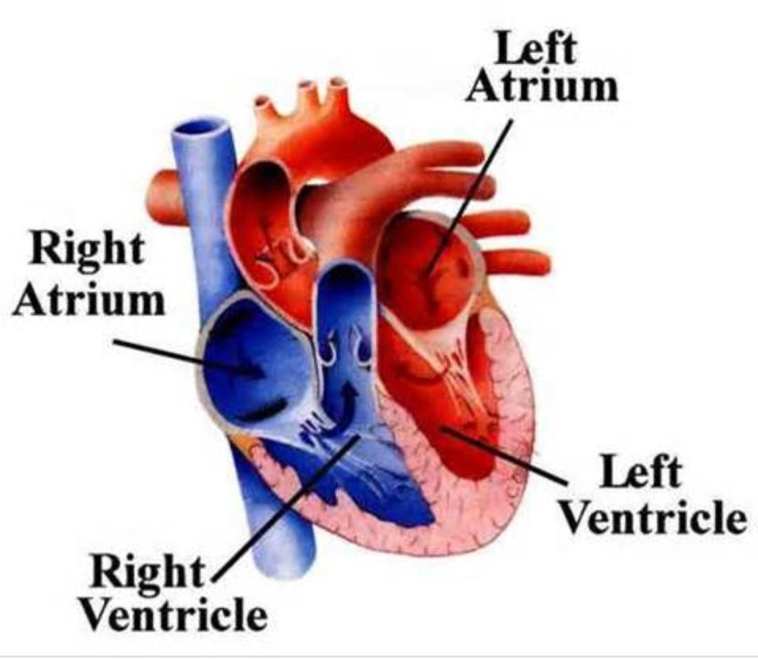
Crash and Burn- The World is Lovesick
Heart has 4 chambers
So this class will have 4 Chambers just like my book, Peaceful Hearts, Zealous Hearts:
Encouragement (Double Consolation)
Keep it Real- Keep The Antidotes, not the Ills of Modernity
Get Going With the Devotions
Mercy

Slide 5
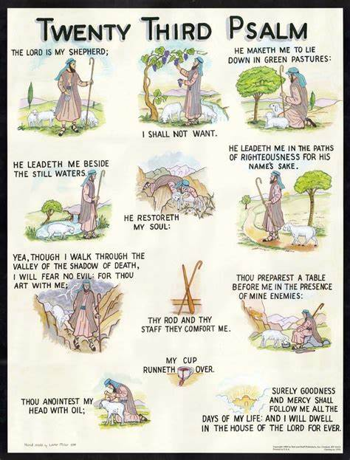
Preliminary Notes
Systematic and Pastoral Theology (Ps. 23)
Systematic Theology: Theological approach people to learn the truths of the faith
Pastoral Theology: Theology taught from the perspective of what people need to bring them closer to God and to live it out in their lives
They compliment and support each other and are NEVER CONTRADICTORY

Slide 6
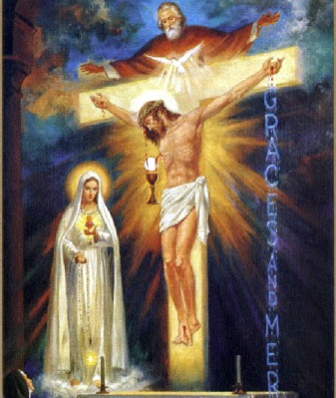
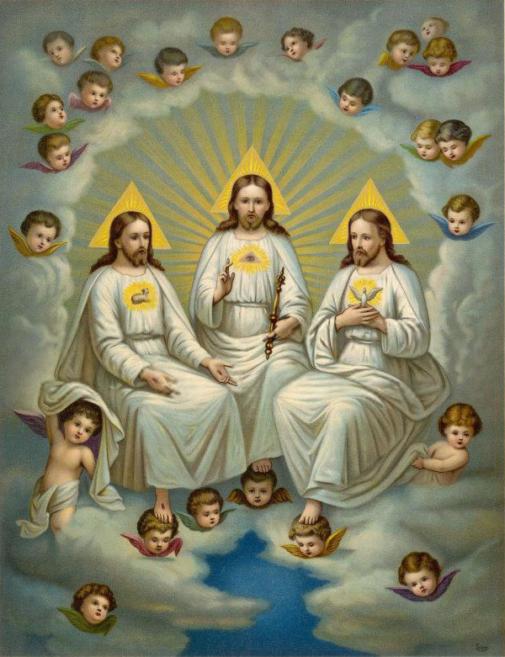
Preliminary Notes
What’s my name!!: Internal and External Glorification of God
Internal Glorification: The Glory of God inside the God-Head (cannot change)
External Glorification: The glory of God according to creation (can vary according to creatures)
God’s Immutability and Impassibility lining up with Communication of Idioms
Immutability: God does not change (Trinitarian)
Impassibility: God does not have passions as pure spirit (Trinitarian)
Communication of Idioms: The Divine Person Jesus Christ is truly God and truly man so what is said about one nature can be said about the other in Christ because He is one person with two natures (Christological)

Slide 7
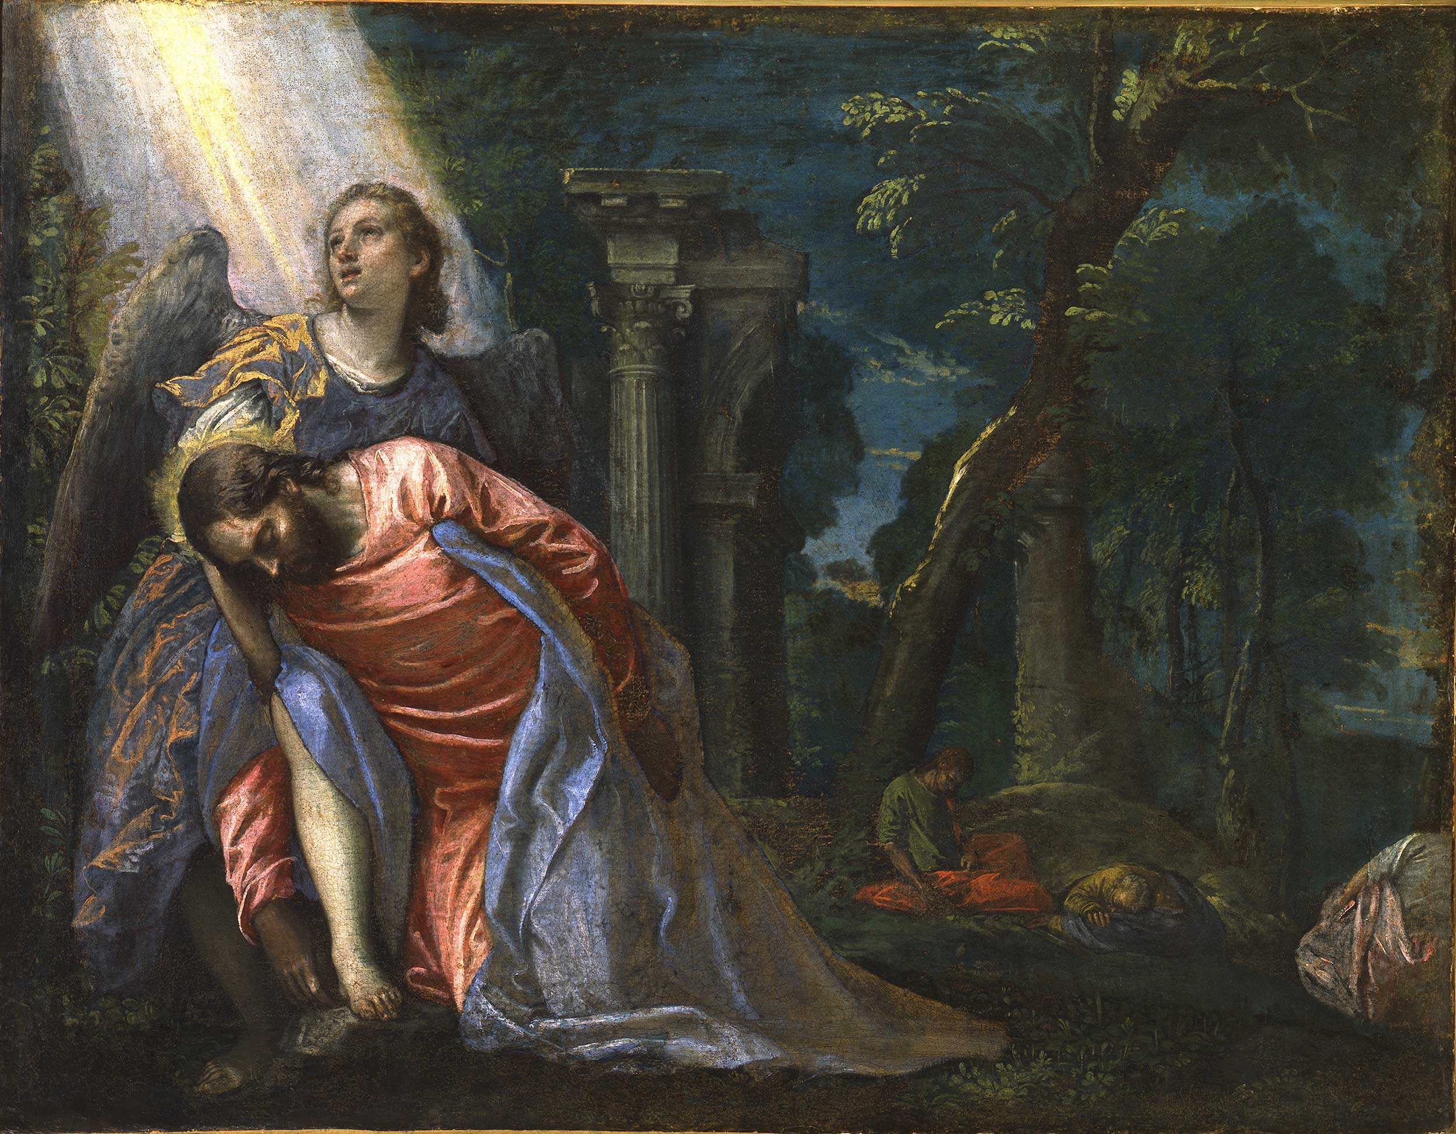
Chamber 1: Encouragement (Double Consolation)
God
Gen. 6:5-7
Lk. 22:41-43
Man
Original Sin
Murder, slander, selfishness, pride, lust, envy, atheism
All of Scripture

Slide 8
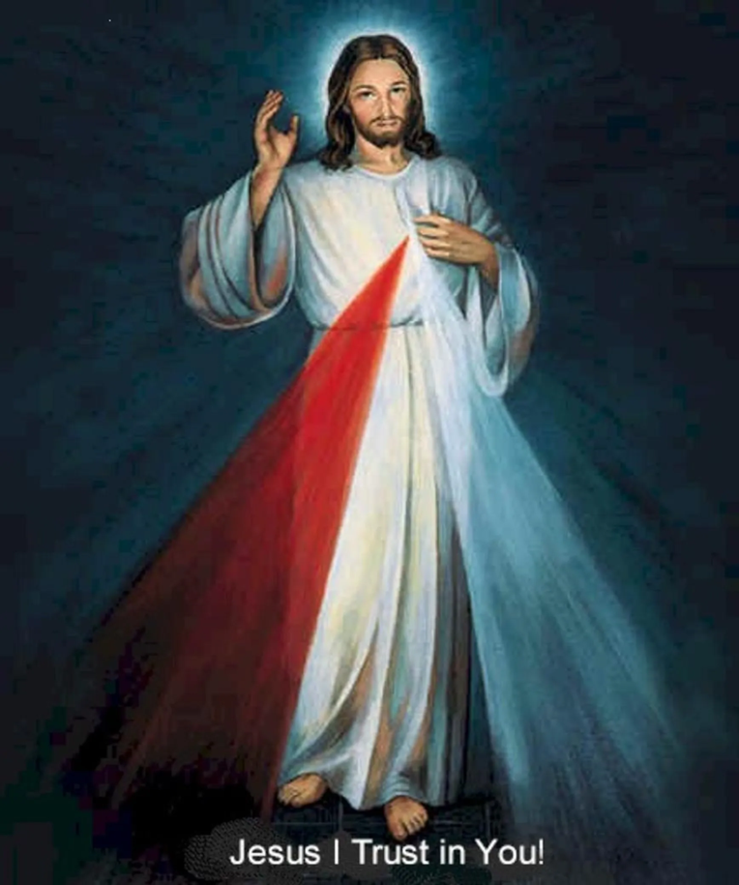
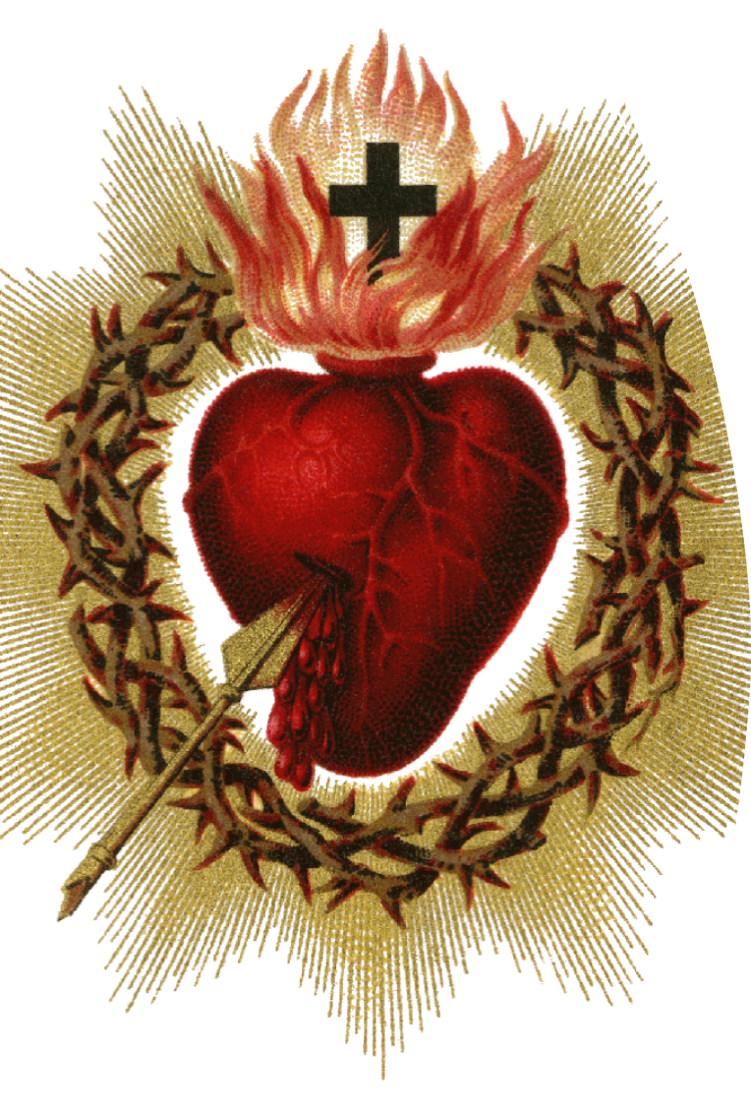
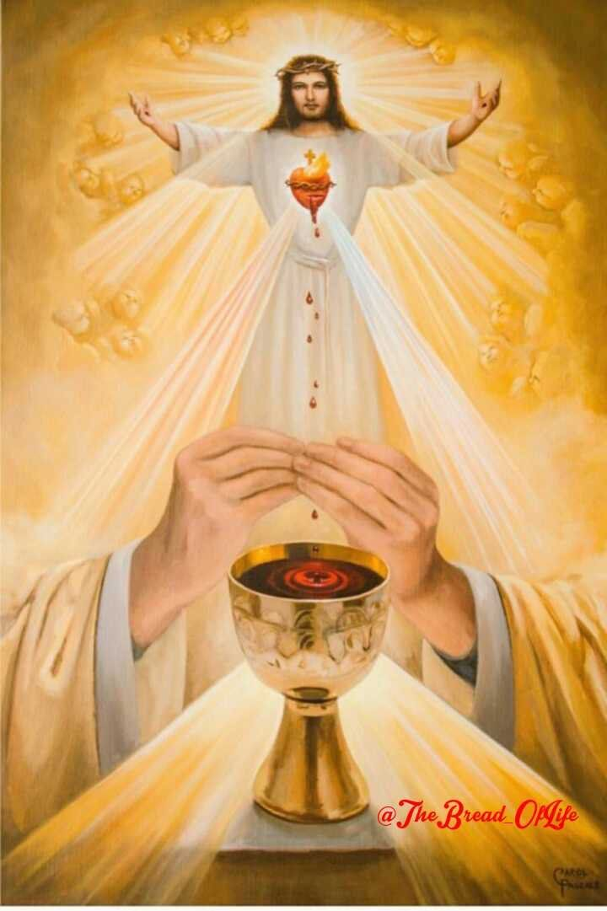
Chamber 1: Encouragement (Double Consolation)
The Lord be with you
And with your spirit
Lift up your hearts
We lift them up to the Lord
Let us give thanks to the Lord our God
It is right and Just

Slide 9
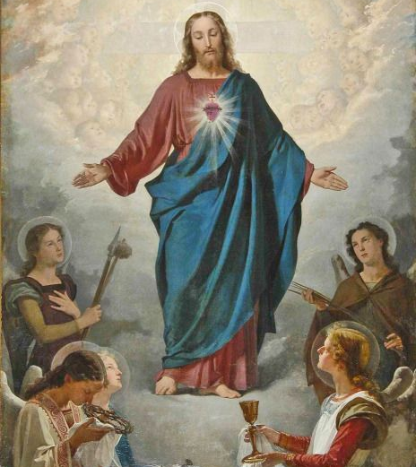
Chamber 1: Encouragement (Double Consolation)
“In mercy, God consoles the heart of man. At the same time, God deserves our response of love, a consolation, so to speak, in justice to Him. These come together in Jesus. As Pope St. John Paul II notes: Jesus Christ is “the human face [and heart] of God and the divine face [and heart] of man.” (p.14)
God
Gen. 6:5-7
Lk. 22:41-43
Man
Original Sin
Murder, slander, selfishness, pride, lust, envy, atheism
All of Scripture
Double Consolation
There is a consolation of God (devotion to the Sacred heart) and
Then the consolation of man (devotion to the Divine Mercy)
Together there is the consolation of the Totus Christus

Slide 10
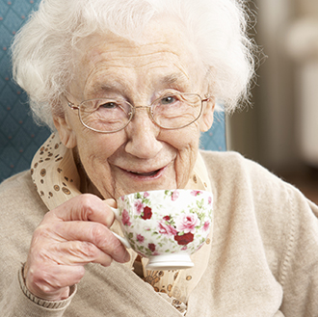
Chamber 2: Keeping It Real- Keep The Antidotes, not the Ills of Modernity Mrs. Tooey
The Lord doesn’t want us “salty”; he wants us to rest in His Eucharistic Heart which we remember at benediction reminds us that the bread and heart/mercy from Heaven as
“having all sweetness within it.”

Slide 11
Poison…in the beginning
Adam and Eve in Truth
Adam and Eve in Love
Adam and Eve with Dynamic Memories
This poison is objective (when it attacks truth-heresy)
Poison is subjective when it attacks (our wills/decisions/ and the way we live)

Slide 12
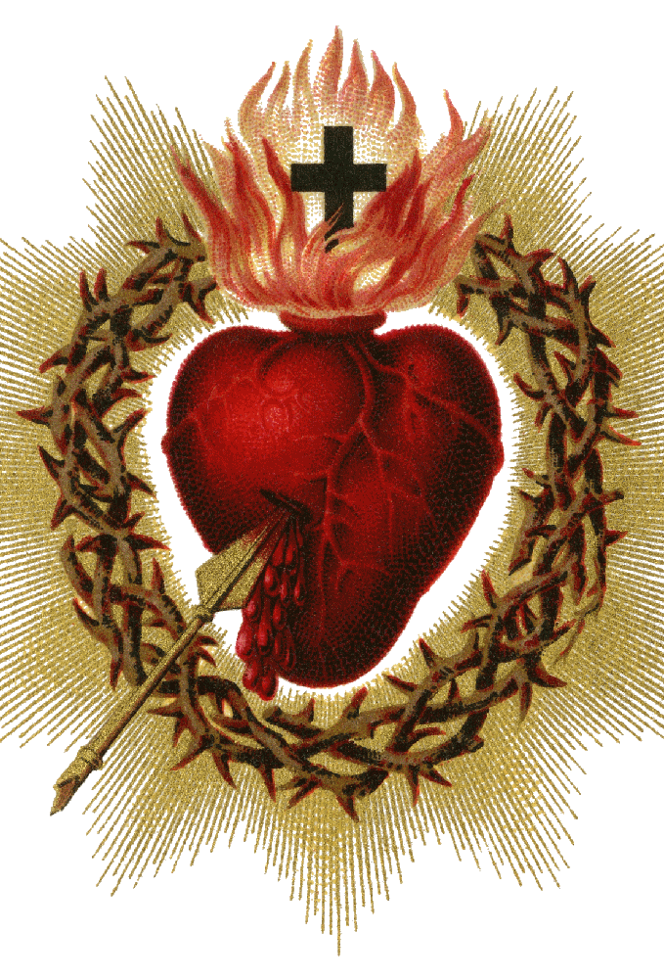
Objective Poison (Heresy) and Antidotes
Sacred Heart Antidote
Jansenism: We had to be worthy for God to love us
We are only defined by our faults
Neo-Jansenism= Cancel Culture
Iconoclasm: Matter is not worthy of God or goodness.
It is something that needs to be destroyed so we can truly be free or good
Neo-Iconoclasm = Gender Ideology

Slide 13
Objective Poison (Heresy) and Antidotes
Divine Mercy Antidote
Modernism: Synthesis of All Heresies- Pope Saint Pius IX
Neo-Modernism= Progressivism
Gnosticism: Salvation comes through Knowledge
Neo-Gnosticism = “Being Woke”
Gen. 3:4
“Your eyes will become opened and you shall be like God”

Slide 14
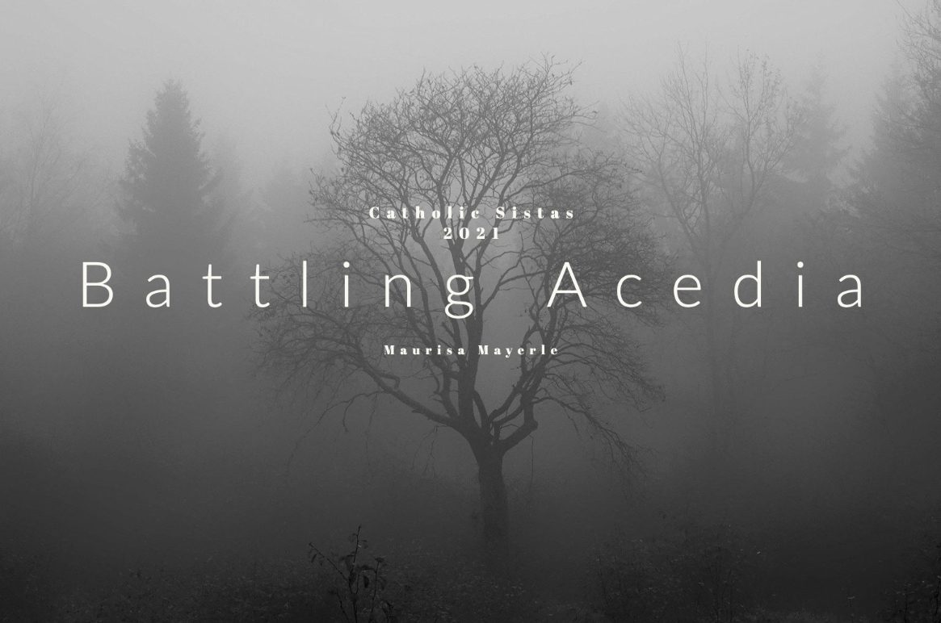
Subjective Poison (Pastoral/Moral Poison) and Antidotes
Acedia
To refuse the joy that comes from God and to be repelled by divine goodness (CCC#2094)
The noon-day devil
Wanting to leave the room

Slide 15
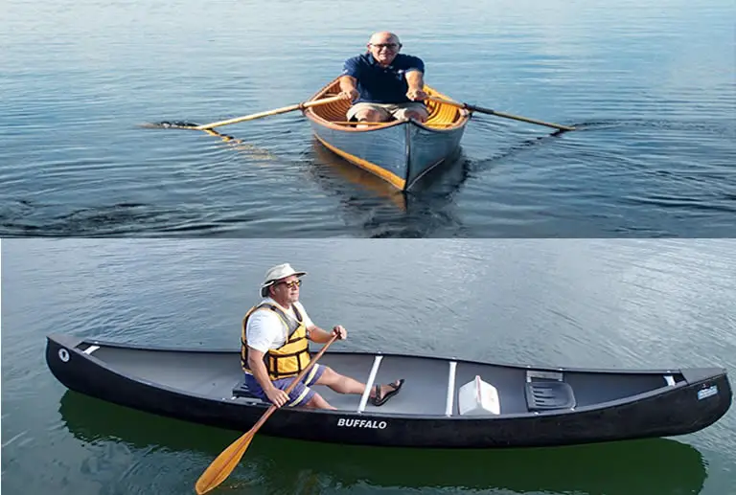
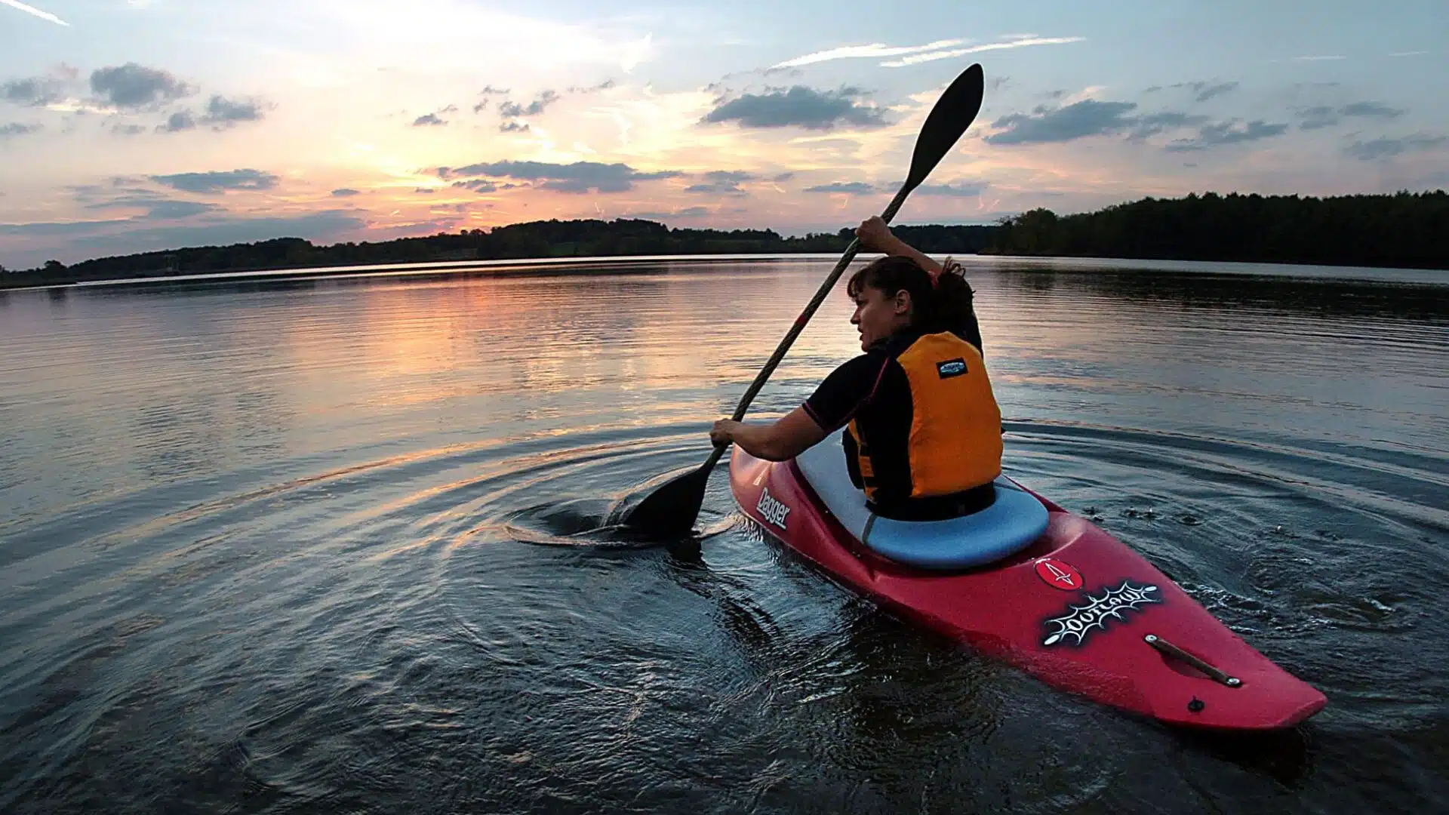
Subjective Poison (Pastoral/Moral Poison) and Antidotes
Spiritual or Religious
Spiritual: Heart without action/refusing to walk towards the beloved
“Religious-ritualism”: Action without heart

Slide 16
Chamber 2: Keeping It Real- Keep The Antidotes, not the Ills of Modernity

Slide 17
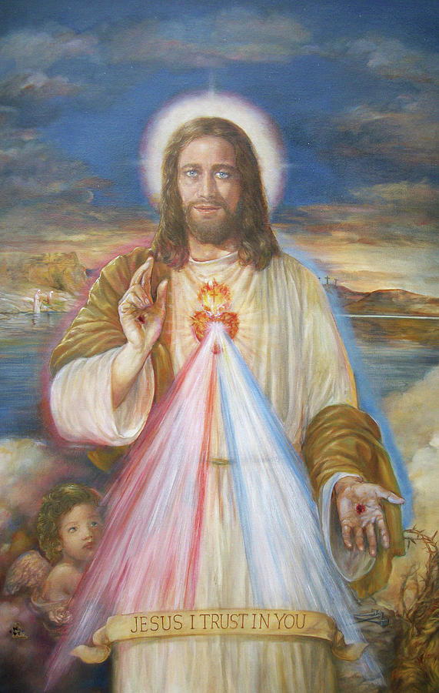
Chamber 3: Get Going With the Devotions
Divine Mercy- FINCH
Feast
Image
Novena
Chaplet
Hour of Divine Mercy
Sacred heart- ST FIT (Fit ST-saint)
Dec. 27, 1673: 33 Thirty-Three Visits Devotion
July 2, 1674: Image of the Sacred Heart (Enthronements and Badge)
July, 1674: First Fridays (Nine)
July, 1674: Thursday Night Holy Hour (11pm)
June, 1675: Solemnity of the Sacred Heart

Slide 18
Chamber 4: Mercy
Brings Reconciliation and Communion
Misercordiae

Slide 19
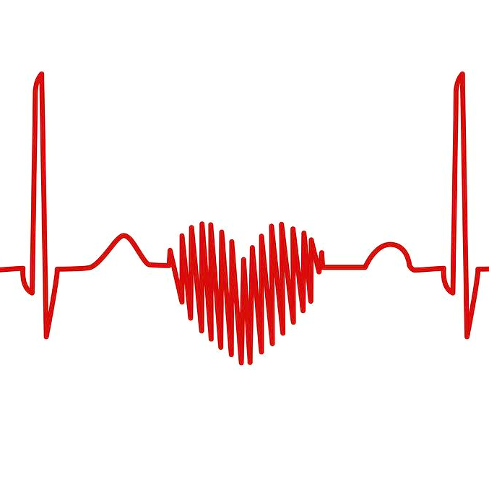
Conclusion
4 Chambers of Heart just like my book, Peaceful Hearts, Zealous Hearts:
Encouragement (Double Consolation)
Keep it Real- Keep The Antidotes, not the Ills of Modernity
Get Going With the Devotions
Mercy

Slide 20
Peaceful Hearts, Zealous Hearts
If you want to help spread the EKG of mercy, get a copy of the book at: https://sophiainstitute.com/product/peaceful-hearts-zealous-hearts
For Kindle E-book version, Click here or go to: https://www.amazon.com/Peaceful-Hearts-Zealous-Devotions-Complementary-ebook/dp/B0D4R456VN/ref=tmm_kin_swatch_0?_encoding=UTF8&qid=&sr=

