Slide 1
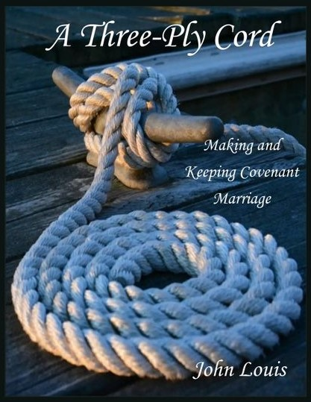
“Where one alone may be overcome, two together can resist. A three-ply cord is not easily broken.” Eccl 4:12

Slide 2
Author and Presenter:
John Louis
MA Theology / MA Education
Husband (45 +)
Father (4)
Sailor – Retired USN Chief and avid sailing skipper

Slide 3
Introduction
Boundaries – Christian Marriage from the Catholic perspective of Sacrament
The ‘Parable of the Cord’
The Fibers That Create the Strands
The Three Plys
Covenant Commitment
Speaking out of Love
Healing Wounds
The example you give at the altar
Epilogue
Notes:
+ Come Holy Spirit…
Boundaries – This discussion and the book are taken from the Catholic Christian Perspective. The Catholic Church considers the Tradition and Scriptures and teaches that marriage is between a man and a woman, a sacrament of service to each other and the Church, the Body of Christ.
Parable – Why ‘a cord’? And why a ‘three-ply’ cord? Eccl quote is an ancient proverb and Truth.
Fibers – What do you believe? Where Christian faith is concerned there are principles a person is asked to discipline themselves to. This discusses some of those fundamental principles.
The Three Strands – woman, man, God. As the proverb says; one may be overcome, two may be stronger, with the third greater strength is added
Covenant – a life-long commitment of self to another and for another. Not 50 -50
Speaking – speech is the power of creation. God said ‘let there be…’ and it appeared. Don’t want to believe allegory? How about modern commercials on radio/TV/internet?
Healing – the fibers will break. ‘Life gets in the way’. How do we heal?
The Altar – the source and summit of Christian Faith (not just Catholic) is the New Testament of ‘do this in remembrance of Me’. Catholic Mass is heavenly worship
Epilogue – Intensions – how the book is a useful tool
Closing – Two examples and the Lord’s Prayer

Slide 4
Boundaries – Christian Marriage from the Catholic perspective of Sacrament
Genesis 1 & 2
Wedding at Cana
Mark 10/Matthew 19
Sacrament
a visible sign of an invisible reality
- and -
Instituted by Christ and gives grace

Slide 5
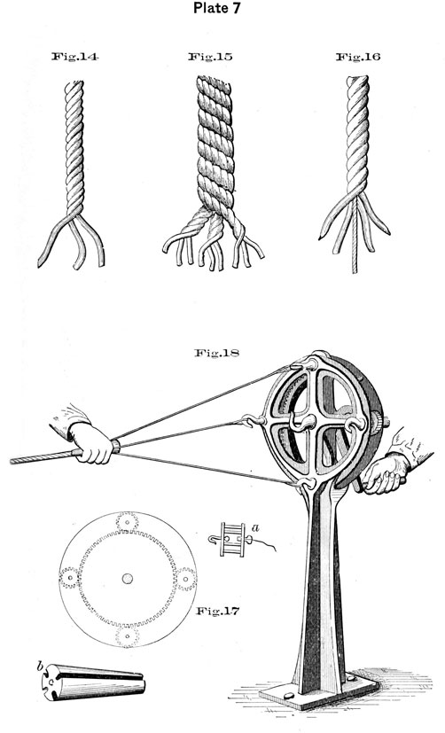
The ‘Parable of the Cord’
Making cord and rope requires
a usable fiber,
binding the fiber into stronger threads
Twisting threads into even stronger rope
Let’s take a look
https://www.youtube.com/watch?v=WL0WOiBY0l8

Slide 6
The ‘Parable of the Cord’
Note the beginning had to be with a strong natural fiber
The twisting of the fiber gives is more strength, adding a spring to help it keep its shape
The twisted fibers are joined by a counter twist. It helps hold the original twist
and allows the entire cord to hold its larger shape, combining the strength of the
three.

Slide 7
What do you believe? The Fibers That Create the Strands
Ropes and cords can be made of different types of materials. Jute, hemp, flax, tree bark, papyrus… each has its own quality. They can be bound together. The strength of the cord created is only limited by the one that is weakest.
Each of us grows from our youth learning what principles we will or will not live by. It is the nature of us that we have a diversity of perspective and character based on our experiences and our chosen disciplines.
Courtship between couples is about finding the ‘fibers’ of principle that are
compatible.
These are the principles that frame the Christian faith and shape Christian action:

Slide 8
What do you believe? The Fibers That Create the Strands 2
The Ten Commandments
I AM…the Lord thy God. | Do not take My Name in vain… | Keep holy the Sabbath | Honor your father and mother | Thou shalt not kill
Thou shalt not commit adultery… | Thou shalt not steal… | Thou shalt not bear false witness | Thou shalt not covet another’s spouse… | Thou shalt not covet another’s goods (wealth)
The Virtues
Theological | Cardinal
Faith | Fortitude
Hope | Prudence
Charity (Love) | Justice
 | Temperance

Slide 9
What do you believe? The Fibers That Create the Strands 3

Slide 10
Ply 1 of 3 Covenant Commitment
Who is your best friend? …and why are they your best friend?
Now, who are your life-long friends? …and what holds you together?
Likely, in both cases, your friendships have been tried and tested. You must have found some common ground.
The Lord God said to Abram, “Go forth from your land…I will make of you a great nation…All the families
of the earth will find blessing in you.” Gn12: 1-4
“Abram put his faith in the Lord, who attributed it to him as an act of righteousness.” Gn 15:6
The Lord appeared to Abram and said: “Walk in my presence and be blameless.
Between you and me I will establish my covenant,…” Gn 17:1-9
I AM the Lord. I will free you from your burdens…and will deliver you from…slavery. I will take you as My own people” Ex 6:6, 7
“When you make a vow to the Lord, …you shall not delay in fulfilling it;” Dt 22
“Wherever you go I will go, wherever you lodge I will lodge…and your God, my God” Ru 1:16-18
“My sister, come, let us pray an be our Lord to grant us mercy and protection.” Tobit 8:4
“Cherish your friend, keep faith with him;…for a wound can be bandaged, and an insult forgiven…” Sirach 27, 17, 21

Slide 11
Ply 1 of 3 Covenant Commitment
“But from the beginning of creation, God made them male and female. …a man shall leave his family and be joined to his wife and the two shall become one flesh. Therefore, what God has joined, no hum being must separate.” Mt 19: 4 - 6
“Take and eat; this is my body. Take and drink; this is my blood of the covenant. Do this is remembrance of me.”
“Love…bears all things, believes (faith) all things, hopes all things, endures (fortitude) all things.” 1Cor13; 4, 8
“Be subordinate to one another out of reverence for Christ.” Eph 5:21
I will send the Advocate to you… the Spirit of Truth, he will guide you to all truth.” Jn 16:8, 12
No trial has come to you but what is human. God is faithful and will not let you be tried beyond your strength;” 1Cor 10:13

Slide 12
Ply 2 of 3 Speaking – Divine Gift of Creation
Ideas;
“We hold these
Truths to be self-
evident…”
“I now pronounce you
husband and wife.”
“Do you come here
freely?”
“I do.”
“I love you…”
“…for as long as you both
shall live?”
“I do.”
Song …
Your name called out,… the sweetest sound.
and prayer…
“WE, the People…”
Power of speech is creative.
Expressing internal thoughts
“I hate you!”
“You’re wrong.”
“F@&% YOU!”
“I’m angry with you!”
“You’re dressed like that?!”
“I’m leaving you.”
(silence)
“Go to hell”
“You’re a sorry S.O.B…”

Slide 13
Ply 2 of 3 Speaking – Divine Gift of Creation
And God said, “Let there be Light…”
Sixteen times ‘God said’ in Genesis, creating the world. To speak is the power to
bring something of value into our reality. It is the power of creation, the beginning
of ideas and communication to others.
“And God said it was good, very good!”

Slide 14
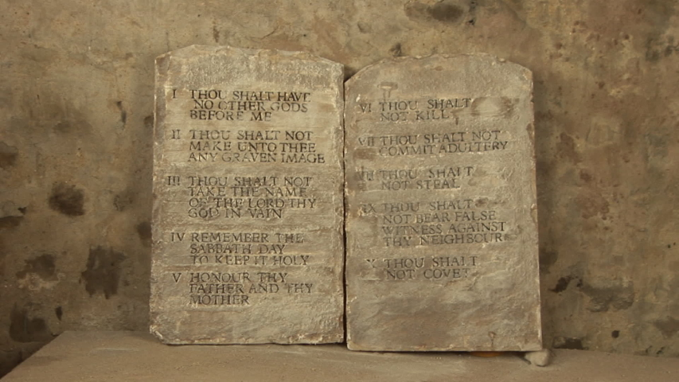
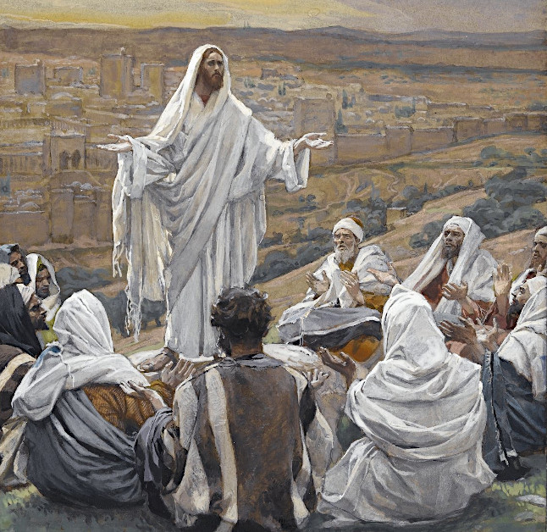
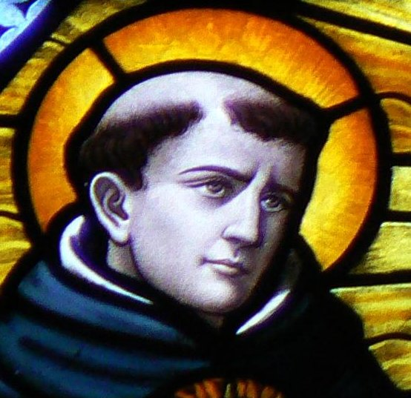
Ply 2 of 3 Speaking – Divine Gift of Creation
Two of Ten Commandments address speaking:
- Thou shalt not take the name of thy Lord in vain.
- Thou shalt not bear false witness against thy neighbor.
Jesus addresses the Decalogue in Matthew’s
account of the Sermon on the Mount…
“You made the workman’s body for him; his mind able to command his limbs…”
Augustine; Confessions
Loving results from right thinking turned into right action, and speaking reveals to others the intention and purpose driving our actions.
Intellectual…inward man;
Sensitive…outward man.
St. Thomas Aquinas

Slide 15
Ply 2 of 3 Speaking – Divine Gift of Creation
“Lord, who may abide in your tent? Who walks without blame, doing what is right, speaking truth from the heart; Who does not slander with the tongue,… Ps 15
Keep your tongue from evil, your lips from speaking lies.” Ps 34
Those who guard mouth and tongue guard themselves from trouble.” Pv 21
Either declare a tree good and its fruit is good, or declate the tree rotten and its fruit is rotten, for tree is known by its fruit.” Mt 12:33
“Hear and understand. It is not what enters one’s mouth that defiles one. …But the things that come out of the mouth come from the heart,… Mt 15:11, 18
Therefore, putting away falsehood, speak the truth, each one to his neighbor; for we are members one of another.” Eph 4:25
“Avoid profane, idle talk…” 2 Tim 2:16

Slide 16
Ply 3 of 3 Healing the Wounds of the Embodied Spirit
Every part of our soul suffers pain;
The body hurts physically
The conscience struggles to focus
The mind is bound in the struggle to deal with the pain and keep the body going
When was your last headache?
How bad was it?
What is your ‘cutoff’ point of dealing with pain and taking medication?
When was the last time you had a fight with a friend? …your spouse? ….parent? …child?
How did you, or, did you resolve it?
Have you ever been so stressed you couldn’t sleep?
…couldn’t eat?
And what happens if that continues for days & weeks?

Slide 17
Ply 3 of 3 Healing the Wounds of the Embodied Spirit
And when He had said this, He breathed on them and said to them, “Receive the holy Spirit. Whose sins you forgive are forgiven them,…”
Jn 20:22, 23
We are called to emulate Christ. We cannot keep ourselves from doing any less than this.
“You brought a dead body back to life from Sheol, by the will of the Lord. Nothing was beyond his power…” Sir 48:5, 13
Those live whom the Lord protects; yours is the life of my spirit. Behind your back you cast all my sins. Is 38:16, 17
Simon’s mother-in-law was afflicted with a sever fever, and they interceded with Him…He stood over her, rebuked the fever, and it left her.” Lk 4:38, 39
“Which is easier to say, ‘Your sins are forgiven’ or ‘Rise, and walk’? Lk 5:25
Peter said, “I have neither silver nor gold, but what I do have I give you: in the name of Jesus Christ the Nazorean, rise and walk.” Acts 3: 5, 6

Slide 18
Ply 3 of 3 Healing the Wounds of the Embodied Spirit
We are baptized priests, prophets, and kings; our discipleship includes ritual prayer, teaching the faith, and taking responsibility for all we are blessed with.
We are anointed with Chrism, and opened to the gifts of the Holy Spirit, whose gifts are expressions of wisdom, knowledge, faith, gifts of healing, mighty deeds, discernment of spirits, interpretations of tongues. 1 Cor 12:4 – 11
Healing the physical, psychological, mental and emotional wounds within ourselves and in our relationships IS within the power of the gifts given to us. Christianity is about renewal.
Once again, the question is “What do you believe?”

Slide 19
Ply 3 of 3 Healing the Wounds of the Embodied Spirit
This work, this book/presentation, is about beginning with the Christian faith.
The ‘gift of the Spirit here is ‘expression of wisdom’ through the scriptures.
The intent is to aid in revisiting the foundation of faith.
The goal is to encourage the Conscience of the participant into ‘right thought’ so that ‘right action’ will form ‘good habit’.
This work is NOT about counseling or promising. However
Advice: work with your confessor/priest to begin
Advice: choose companion(s) with like beliefs to walk with you
CAUTION: do NOT choose a companion you might transfer your feelings to!

Slide 20
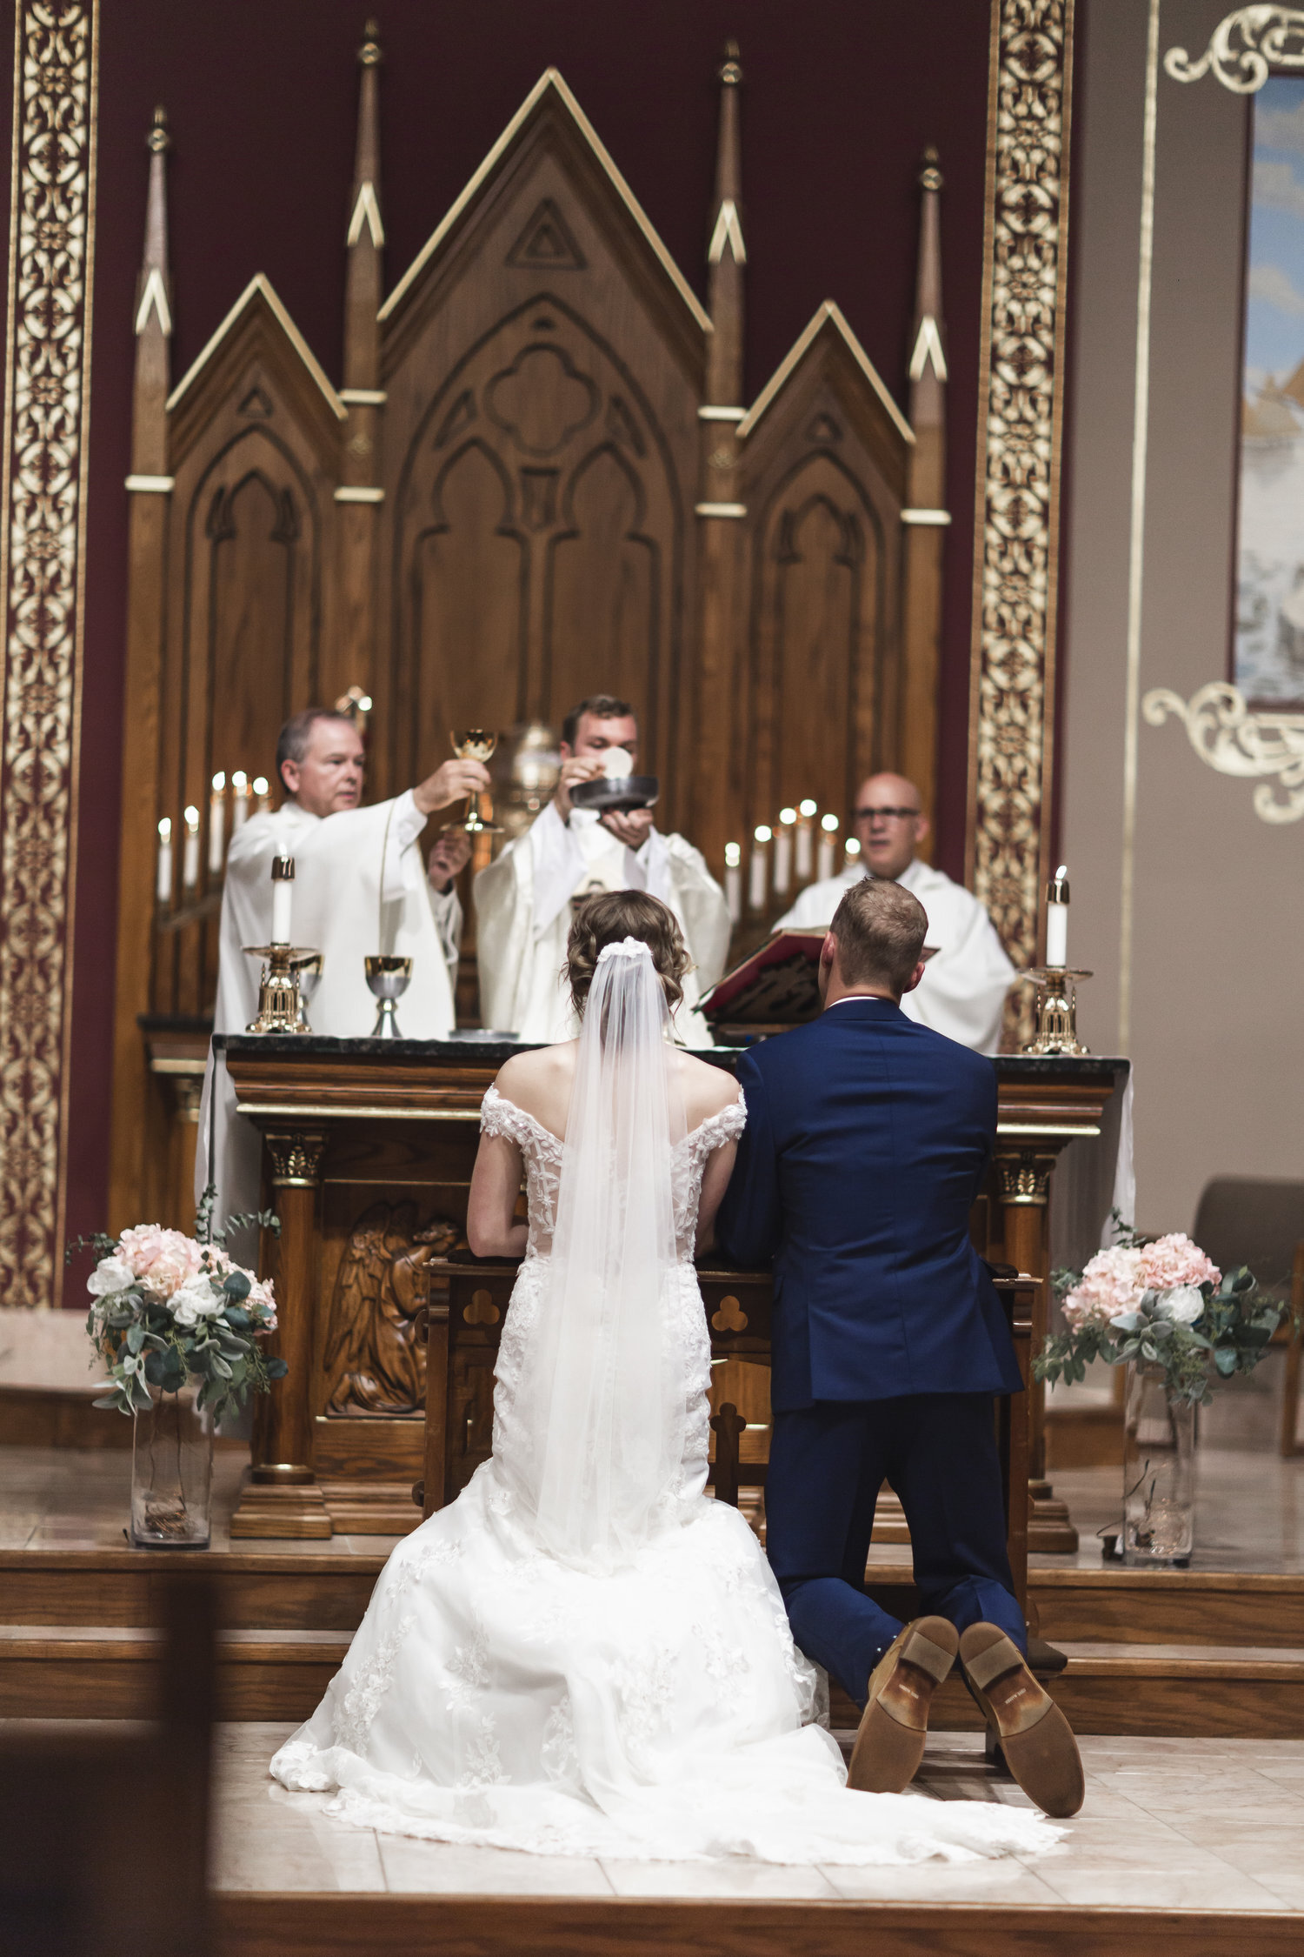
The Example You Give at the Altar
The Eucharist is the source and summit of the Christian Faith. The Sacrament of Marriage is best celebrated through the Mass.
You, as a couple, call the Church together.
You, as a couple, choose the scriptures that reflect your faith on the sacrament you are gifting each other
You, as a couple, lead the Church to the altar to receive the Eucharist, and by receiving profess your faith in the New Testament
You, as a couple, lead the Church out into the world to new life.

Slide 21
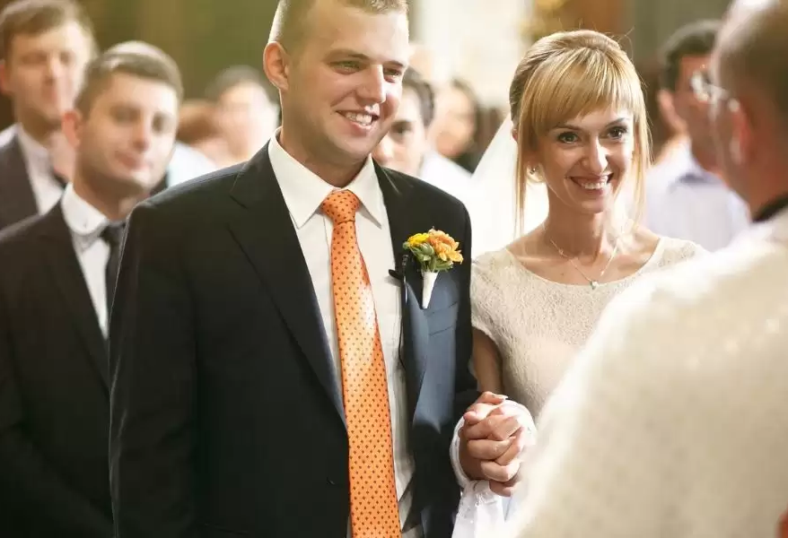
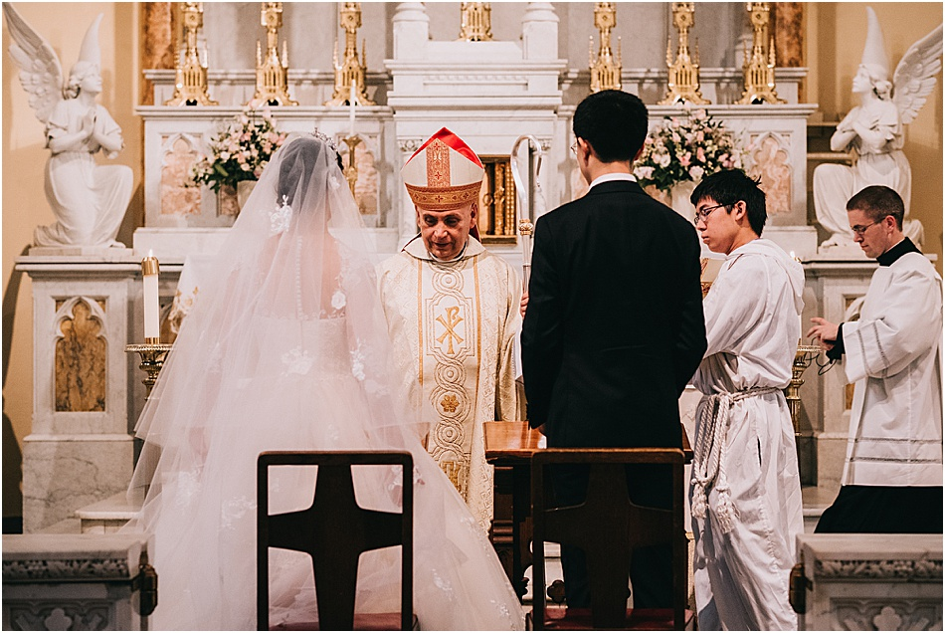
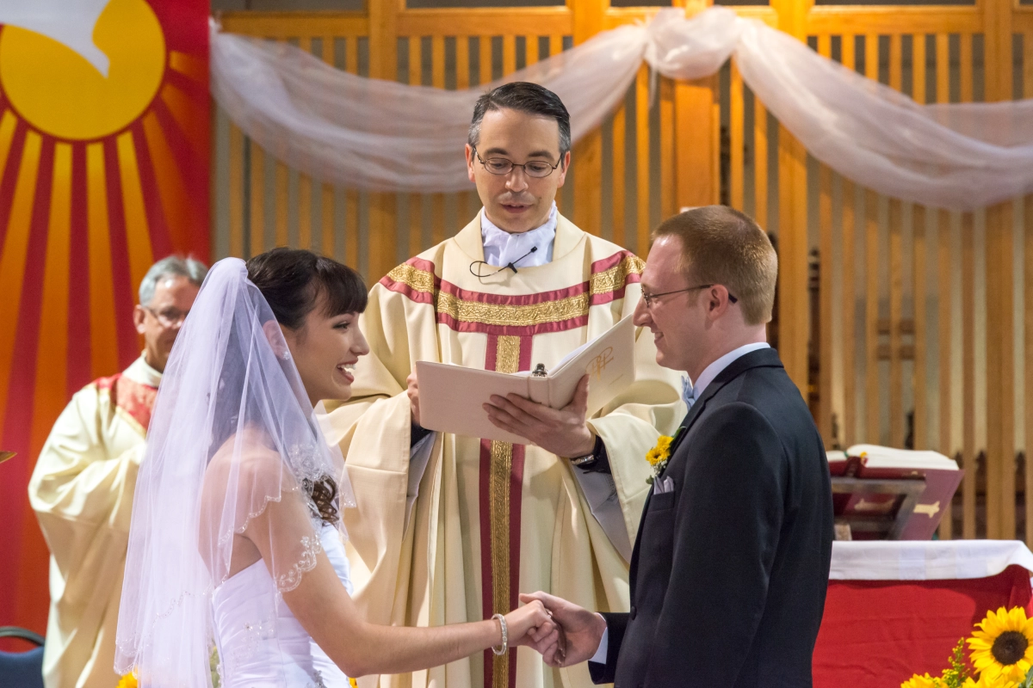
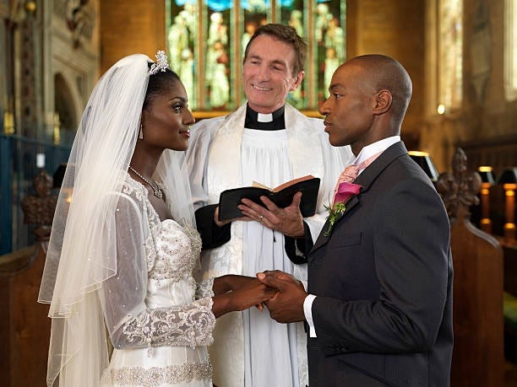
The Vows You Profess at the Altar
Free
No ‘contracts’, no ‘shot guns’, no ‘arrangements’
Faithful
The ‘Other’ is the only ‘other’; body, mind, and spirit, your entire self; 100% and more
“For the husband is made holy through his wife, and the wife made holy through her husband.” 1 Cor 7: 14
Fruitful
Unitive; your life’s goals present a unity of labor
‘Goods’ of Marriage – open to new life and ready to raise that new life in the Faith
Forever
“…as long as you both shall live.”

Slide 22
Epilogue
What do you believe, now?
How are the Ten Commandments a structure for the ideas that followed?
What are the Virtues?
How does the action of Beatitudes fulfill the Kingdom?
What does ‘covenant’ mean?
How does speech affect our life?
Who has the power to heal?
What are the parts of the soul?
What are the Catholic sacramental wedding vows?
Why make them ‘in’ the Church?
Promises made?
Promises NOT made?

Slide 23
Hard Cover
Paperback
E-book
Dorrance Publishing
Pittsburg PA
https://bookstore.dorrancepublishing.com/

Slide 24
Reference Notes
https://www.youtube.com/watch?v=toyOKOi0DsM medieval market
https://www.youtube.com/watch?v=WL0WOiBY0l8 woman making by hand
Ropes have tensile strength and so can be used for dragging and lifting. Rope is thicker and stronger than similarly constructed cord, string, and twine.
The twist of the strands in a twisted or braided rope serves not only to keep a rope together, but enables the rope to more evenly distribute tension among the individual strands.
While friction between the individual wires and strands causes wear over the life of the rope, it also helps to compensate for minor failures in the short run.
Twisted ropes are built up in three steps. First, fibers are gathered and spun into yarns. A number of these yarns are then formed into strands by twisting. The strands are then twisted together to lay the rope. The twist of the yarn is opposite to that of the strand, and that in turn is opposite to that of the rope. It is this counter-twist, introduced with each successive operation, which holds the final rope together as a stable, unified object.
The average rope life-span is 5 years. Serious inspection should be given to line after that point. However, the use to which a rope is put affects frequency of inspection. Rope used in mission-critical applications, such as mooring lines or running rigging, should be regularly inspected on a much shorter timescale than this, and rope used in life-critical applications such as mountain climbing should be inspected on a far more frequent basis, up to and including before each use.

